Slide 1
Kansas Oil & Gas Activity 1889 - 2013

Slide 2
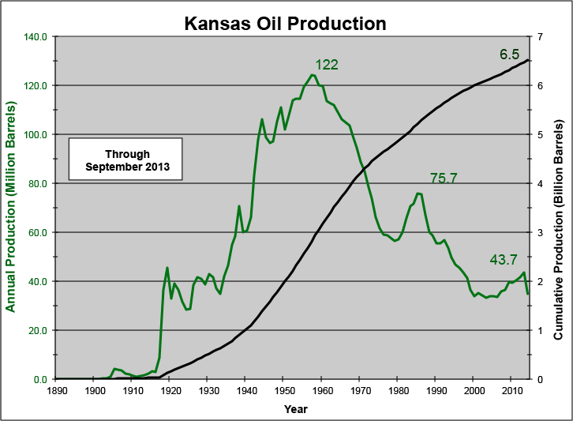
Kansas Historical Oil Production
Notes:
>>>>>>>>>>>>>>
Feel free to pass this email on to anyone that might be interested or let me know and I can add them to the list. Also if not interested let me know and will take you off the list.
I update this data on a more or less monthly basis, but will refrain from sending them out more than quarterly. This is the report for the 2007. 2007 oil and gas production numbers complete, but may be subject to some revision. The near months are incomplete and usually subject to upward revision.
<<<<<<<<<<<<<<<
Attached Power Point slides show Kansas oil and gas production with production and value for 2006 and 2007. The December monthly production for 2006 has just arrived and will probably be subject to some revision with the next monthly report. The average oil production in 2007 was just over than 3,000 MBO/month, which is almost 50 MBO/Month more than average produced in 2006. In a number of recent months, reported production is bouncing around 98,000 to 100,000 barrels per day. This bodes well for continued increases in oil production during 2008.
In 2006, Kansas produced 36.6 million barrels of oil (MMBO), which up very significantly from last year (35.7 MMBO). Kansas oil production has been constant or increasing slightly for more than 8 years (1999). Despite the recent increase, the state's production this year will fall far short of the record of 124 million barrels set in 1956. However, this is the longest and one of the few strings of annual increases in oil production. The last period of increased production was during the period from 1979 to 1985. In 2006 Kansas oil production will have an estimated value at the wellhead of $2.3 billion ($2.18 billion last year), which should continue the surge in the state's energy output and rural economy. The increase in value is a combination of increase in volumes and in price.
In 2007, the value of Kansas gas production at the wellhead stayed at around $2.4 billion. Prices remained steady. The decline in gas production from 2006 to 2006 was around 5 Bcf and continues to decrease. Part of this slowing in decrease in gas production can be attributed to the increase in coalbed methane production in eastern Kansas, which increased from 22 Bcf in 2006 to 35 Bcf in 2007.
In 2007 total value of Kansas oil and gas production at the wellhead was $4.7 billion. This is up slightly from the wellhead value of $4.6 billion in 2006, but is up from the $1.5 to $2.5 billion average of the 90’s. In real dollars, the value remains below the peak of the late 70's and early 80's
Three slides at the end show annual drilling activity in Kansas. I have only used wells with completion or spud dates, but come up with a total of 249,903 wells. We have 390,501 wells in our database, but a significant number are duplicates. One can see that activity has more than doubled since the late 1990’s. Still a long way to go until we reach the activity levels of the early 1980’s. One can also see the emergence of coalbed methane activity in eastern Kansas
>>>>>>>>>>>>>>
Feel free to pass this email on to anyone that might be interested or let me know and I can add them to the list. Also if not interested let me know and will take you off the list.
I update this data on a more or less monthly basis, but will refrain from sending them out more than quarterly.
<<<<<<<<<<<<<<<

Slide 3
Kansas Oil Production
Production Through March 2009
Wellhead Prices Through June 2009
Notes:
http://www.ncrarefinery.com/pb.htm
Kansas Common

Slide 4
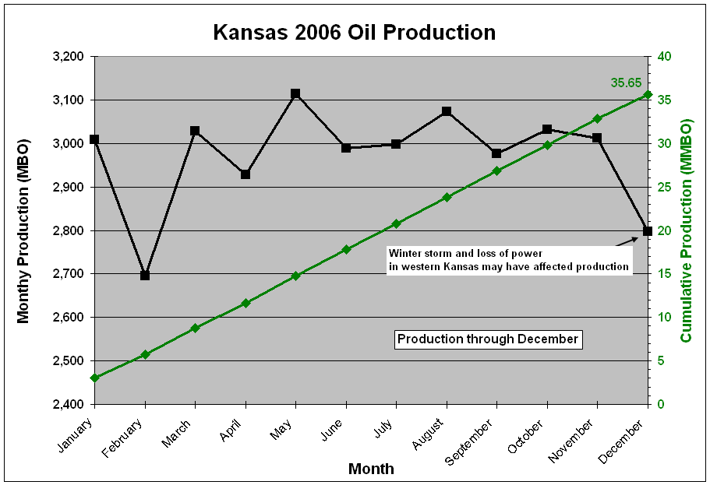
2006 Kansas Oil Production
Notes:
Note last month and often the next to last month are revised upwards as additional production is reported.
Oil Price from Koch Crude Oil - Prices per barrel of 42 U.S. gallons for merchantable crude oil purchased and delivered into pipelines or facilities authorized by KOCH SUPPLY & TRADING,L.P. in Central Kansas

Slide 5
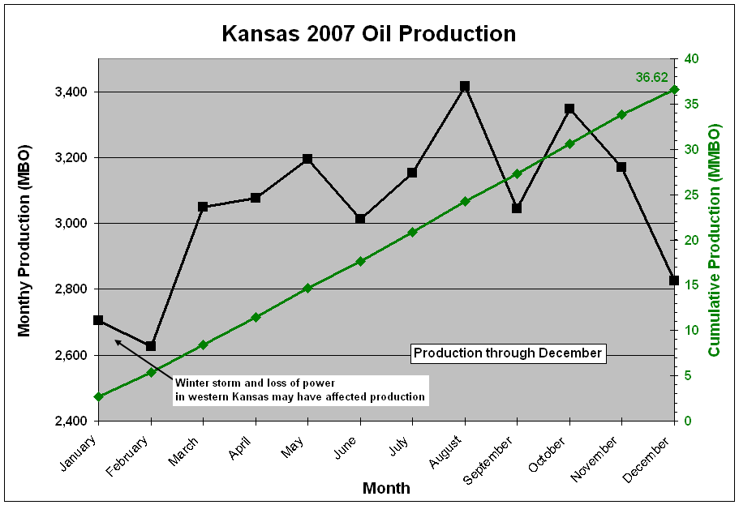
2007 Kansas Oil Production
Notes:
Note last month and often the next to last month are revised upwards as additional production is reported.
Oil Price from Koch Crude Oil - Prices per barrel of 42 U.S. gallons for merchantable crude oil purchased and delivered into pipelines or facilities authorized by KOCH SUPPLY & TRADING,L.P. in Central Kansas

Slide 6
2008 Kansas Oil Production
Notes:
Note last month and often the next to last month are revised upwards as additional production is reported.
Oil Price from Koch Crude Oil - Prices per barrel of 42 U.S. gallons for merchantable crude oil purchased and delivered into pipelines or facilities authorized by KOCH SUPPLY & TRADING,L.P. in Central Kansas

Slide 7
2009 Kansas Oil Production
Notes:
Note last month and often the next to last month are revised upwards as additional production is reported.
Oil Price from Koch Crude Oil - Prices per barrel of 42 U.S. gallons for merchantable crude oil purchased and delivered into pipelines or facilities authorized by KOCH SUPPLY & TRADING,L.P. in Central Kansas

Slide 8
2010 Kansas Oil Production
Notes:
Note last month and often the next to last month are revised upwards as additional production is reported.
Oil Price from Koch Crude Oil - Prices per barrel of 42 U.S. gallons for merchantable crude oil purchased and delivered into pipelines or facilities authorized by KOCH SUPPLY & TRADING,L.P. in Central Kansas

Slide 9
2011 Kansas Oil Production
Notes:
Note last month and often the next to last month are revised upwards as additional production is reported.
Oil Price from Koch Crude Oil - Prices per barrel of 42 U.S. gallons for merchantable crude oil purchased and delivered into pipelines or facilities authorized by KOCH SUPPLY & TRADING,L.P. in Central Kansas

Slide 10
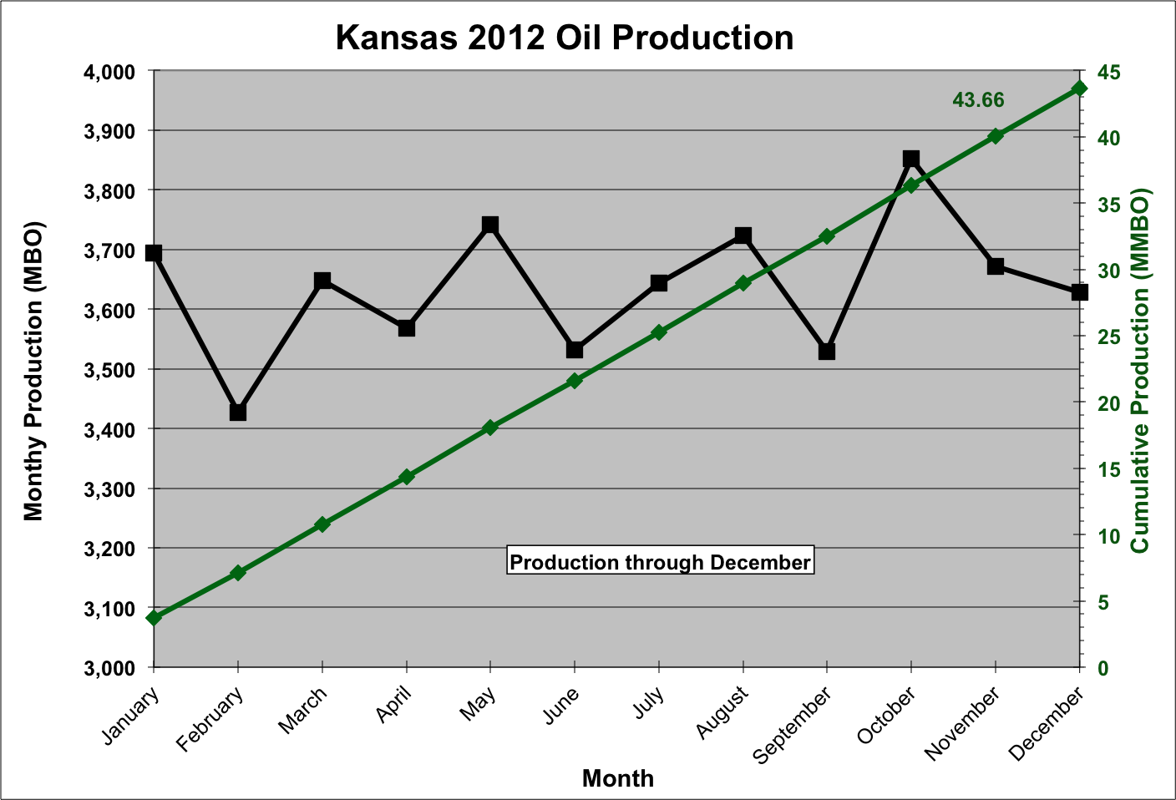
2012 Kansas Oil Production
Notes:
Note last month and often the next to last month are revised upwards as additional production is reported.
Oil Price from Koch Crude Oil - Prices per barrel of 42 U.S. gallons for merchantable crude oil purchased and delivered into pipelines or facilities authorized by KOCH SUPPLY & TRADING,L.P. in Central Kansas

Slide 11
2013 Kansas Oil Production
Notes:
Note last month and often the next to last month are revised upwards as additional production is reported.
Oil Price from NCRA Price Bulletin
http://www.crudeoilsupply.com/CrudeOilSupply/Bulletin/PriceBulletinList?reportingArea=McPherson&country=US&showAll=False

Slide 12
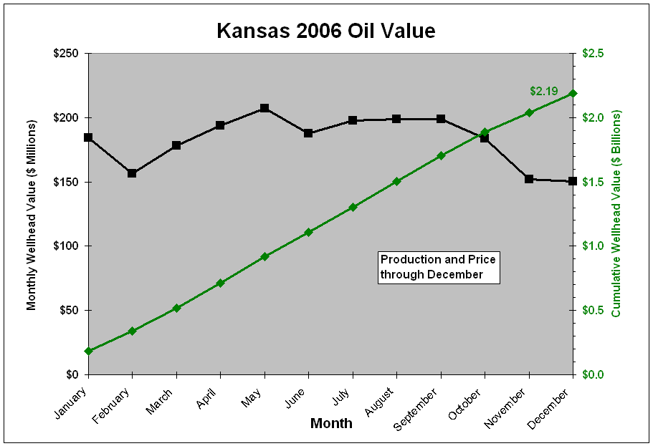
2006 Kansas Oil Value
Notes:
Note last month and often the next to last month are revised upwards as additional production is reported.
Oil Price from Koch Crude Oil - Prices per barrel of 42 U.S. gallons for merchantable crude oil purchased and delivered into pipelines or facilities authorized by KOCH SUPPLY & TRADING,L.P. in Central Kansas

Slide 13
2007 Kansas Oil Value
Notes:
Note last month and often the next to last month are revised upwards as additional production is reported.
Oil Price from Koch Crude Oil - Prices per barrel of 42 U.S. gallons for merchantable crude oil purchased and delivered into pipelines or facilities authorized by KOCH SUPPLY & TRADING,L.P. in Central Kansas

Slide 14
2008 Kansas Oil Value
Notes:
Note last month and often the next to last month are revised upwards as additional production is reported.
Oil Price from Koch Crude Oil - Prices per barrel of 42 U.S. gallons for merchantable crude oil purchased and delivered into pipelines or facilities authorized by KOCH SUPPLY & TRADING,L.P. in Central Kansas

Slide 15
2009 Kansas Oil Value
Notes:
Note last month and often the next to last month are revised upwards as additional production is reported.
Oil Price from Koch Crude Oil - Prices per barrel of 42 U.S. gallons for merchantable crude oil purchased and delivered into pipelines or facilities authorized by KOCH SUPPLY & TRADING,L.P. in Central Kansas

Slide 16
2010 Kansas Oil Value
Notes:
Note last month and often the next to last month are revised upwards as additional production is reported.
Oil Price from Koch Crude Oil - Prices per barrel of 42 U.S. gallons for merchantable crude oil purchased and delivered into pipelines or facilities authorized by KOCH SUPPLY & TRADING,L.P. in Central Kansas

Slide 17
2011 Kansas Oil Value
Notes:
Note last month and often the next to last month are revised upwards as additional production is reported.
Oil Price from Koch Crude Oil - Prices per barrel of 42 U.S. gallons for merchantable crude oil purchased and delivered into pipelines or facilities authorized by KOCH SUPPLY & TRADING,L.P. in Central Kansas

Slide 18
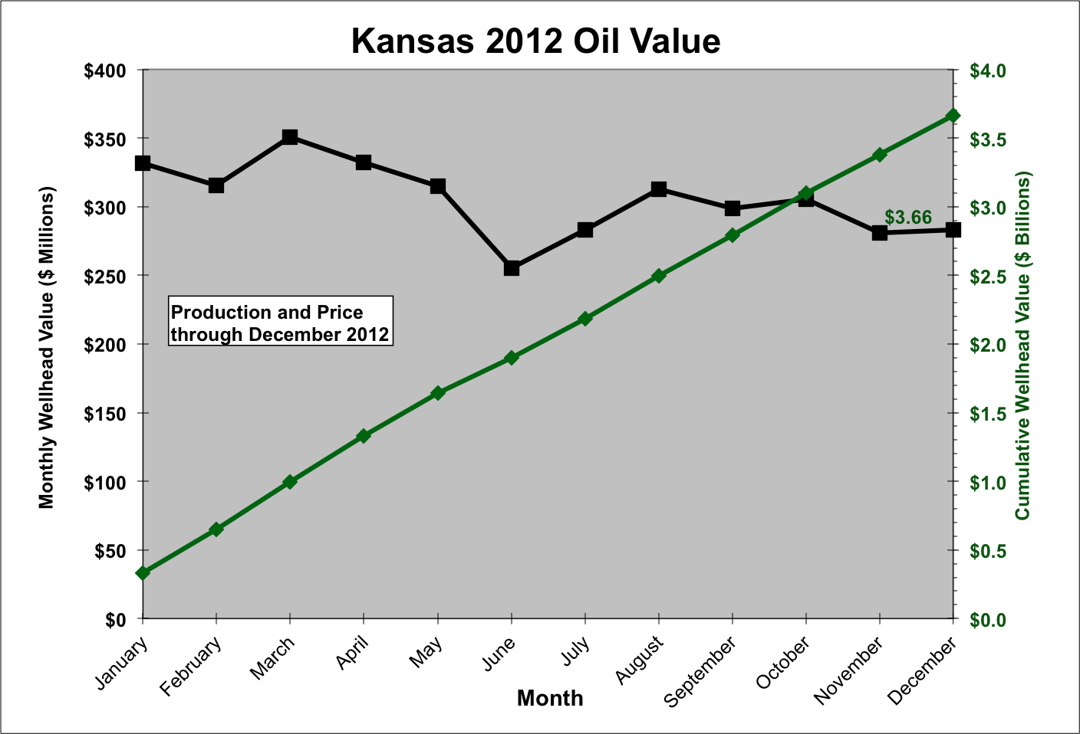
2012 Kansas Oil Value
Notes:
Note last month and often the next to last month are revised upwards as additional production is reported.
Oil Price from Koch Crude Oil - Prices per barrel of 42 U.S. gallons for merchantable crude oil purchased and delivered into pipelines or facilities authorized by KOCH SUPPLY & TRADING,L.P. in Central Kansas

Slide 19
2013 Kansas Oil Value
Notes:
Note last month and often the next to last month are revised upwards as additional production is reported.
Oil Price from NCRA Price Bulletin
http://www.crudeoilsupply.com/CrudeOilSupply/Bulletin/PriceBulletinList?reportingArea=McPherson&country=US&showAll=False

Slide 20
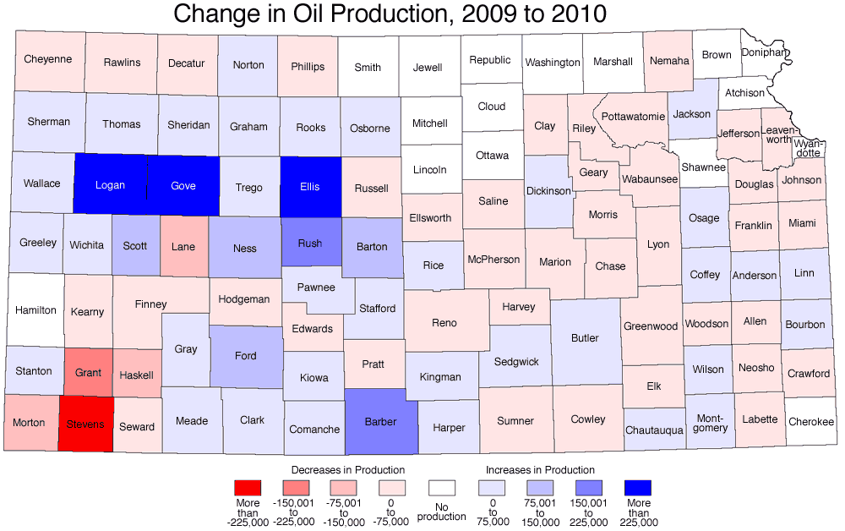
County Oil Production
Notes:
Created June 2008.

Slide 21
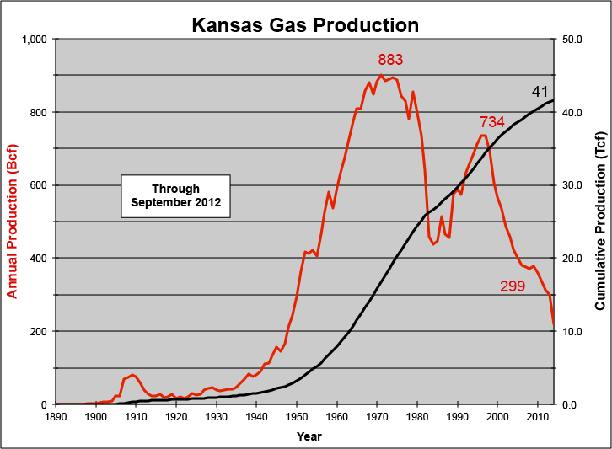
Kansas Historical Gas Production

Slide 22
Kansas Gas Production
Production Through March 2009
Wellhead Prices Through June 2009
Notes:
Wellhead Prices from EIA of the US DOE
http://www.eia.doe.gov/emeu/steo/pub/contents.html#Natural_Gas_Markets (Excel link on right)
Others:
http://www.eia.doe.gov/pub/oil_gas/natural_gas/data_publications/natural_gas_monthly/current/pdf/table_04.pdf
And
http://tonto.eia.doe.gov/oog/info/ngw/ngupdate.asp

Slide 23
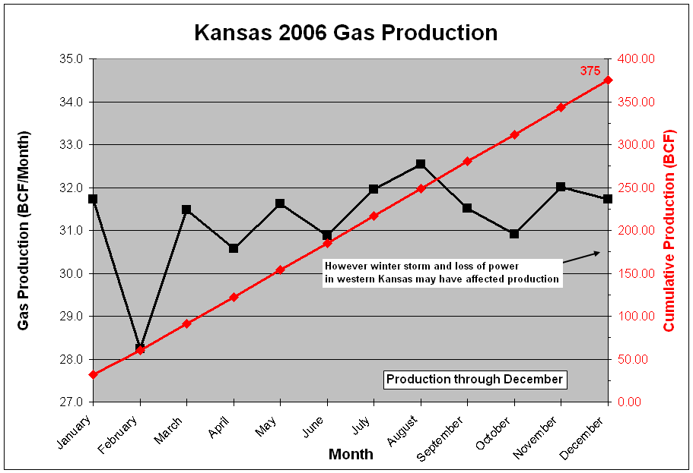
2006 Kansas Gas Production
Notes:
Wellhead Prices from EIA of the US DOE
http://www.eia.doe.gov/pub/oil_gas/natural_gas/data_publications/natural_gas_monthly/current/pdf/table_04.pdf

Slide 24
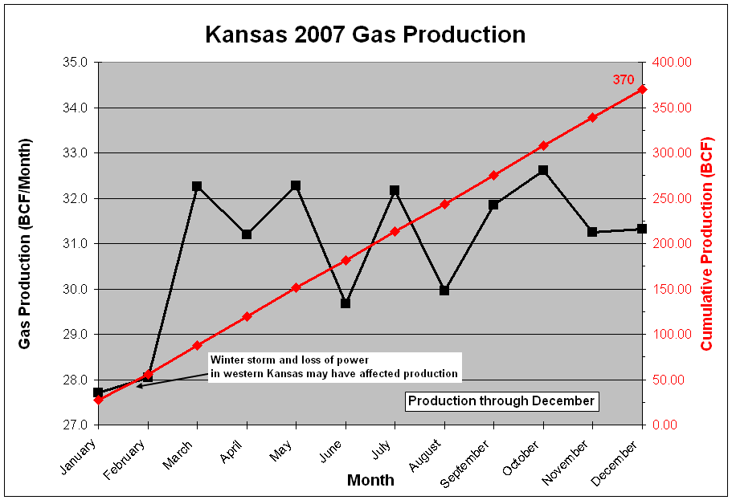
2007 Kansas Gas Production
Notes:
Wellhead Prices from EIA of the US DOE
http://www.eia.doe.gov/pub/oil_gas/natural_gas/data_publications/natural_gas_monthly/current/pdf/table_04.pdf

Slide 25
2008 Kansas Gas Production
Notes:
Wellhead Prices from EIA of the US DOE
http://www.eia.doe.gov/pub/oil_gas/natural_gas/data_publications/natural_gas_monthly/current/pdf/table_04.pdf

Slide 26
2009 Kansas Gas Production
Notes:
Wellhead Prices from EIA of the US DOE
http://www.eia.doe.gov/pub/oil_gas/natural_gas/data_publications/natural_gas_monthly/current/pdf/table_04.pdf

Slide 27
2010 Kansas Gas Production
Notes:
Wellhead Prices from EIA of the US DOE
http://www.eia.doe.gov/pub/oil_gas/natural_gas/data_publications/natural_gas_monthly/current/pdf/table_04.pdf

Slide 28
2011 Kansas Gas Production
Notes:
Wellhead Prices from EIA of the US DOE
http://www.eia.doe.gov/pub/oil_gas/natural_gas/data_publications/natural_gas_monthly/current/pdf/table_04.pdf

Slide 29
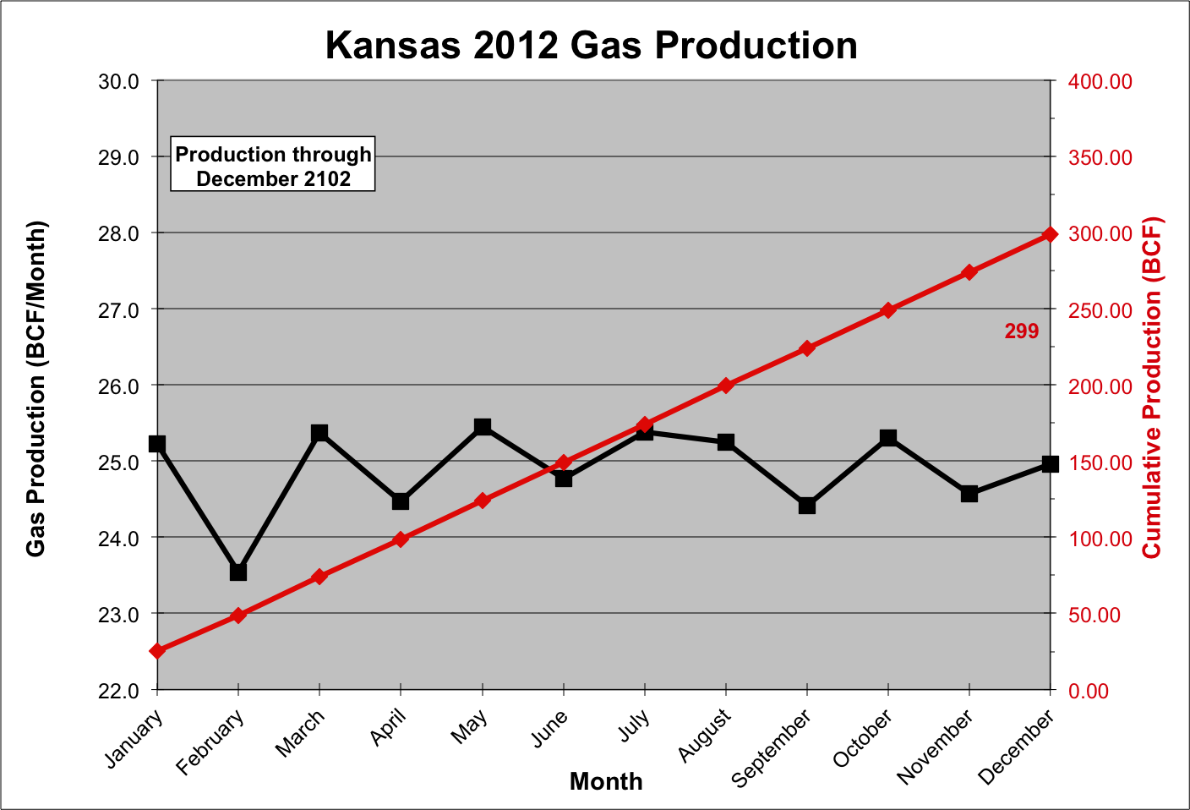
2012 Kansas Gas Production
Notes:
Wellhead Prices from EIA of the US DOE
http://www.eia.doe.gov/pub/oil_gas/natural_gas/data_publications/natural_gas_monthly/current/pdf/table_04.pdf

Slide 30
2013 Kansas Gas Production
Notes:
Wellhead Prices from EIA of the US DOE
http://www.eia.gov/naturalgas/monthly/
Used Natural Gas Spot Price on PDF.

Slide 31
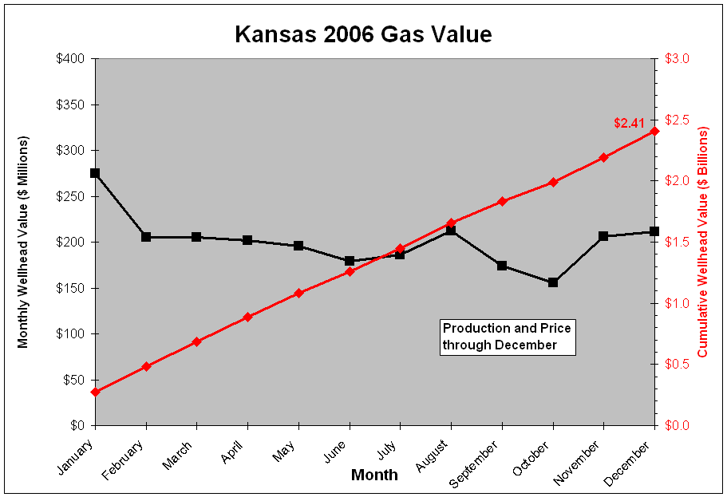
2006 Kansas Gas Value
Notes:
Wellhead Prices from EIA of the US DOE
http://www.eia.doe.gov/pub/oil_gas/natural_gas/data_publications/natural_gas_monthly/current/pdf/table_04.pdf

Slide 32
2007 Kansas Gas Value
Notes:
Wellhead Prices from EIA of the US DOE
http://www.eia.doe.gov/pub/oil_gas/natural_gas/data_publications/natural_gas_monthly/current/pdf/table_04.pdf

Slide 33
2008 Kansas Gas Value
Notes:
Wellhead Prices from EIA of the US DOE
http://www.eia.doe.gov/pub/oil_gas/natural_gas/data_publications/natural_gas_monthly/current/pdf/table_04.pdf

Slide 34
2009 Kansas Gas Value
Notes:
Wellhead Prices from EIA of the US DOE
http://www.eia.doe.gov/pub/oil_gas/natural_gas/data_publications/natural_gas_monthly/current/pdf/table_04.pdf

Slide 35
2010 Kansas Gas Value
Notes:
Wellhead Prices from EIA of the US DOE
http://www.eia.doe.gov/pub/oil_gas/natural_gas/data_publications/natural_gas_monthly/current/pdf/table_04.pdf

Slide 36
2011 Kansas Gas Value
Notes:
Wellhead Prices from EIA of the US DOE
http://www.eia.doe.gov/pub/oil_gas/natural_gas/data_publications/natural_gas_monthly/current/pdf/table_04.pdf

Slide 37
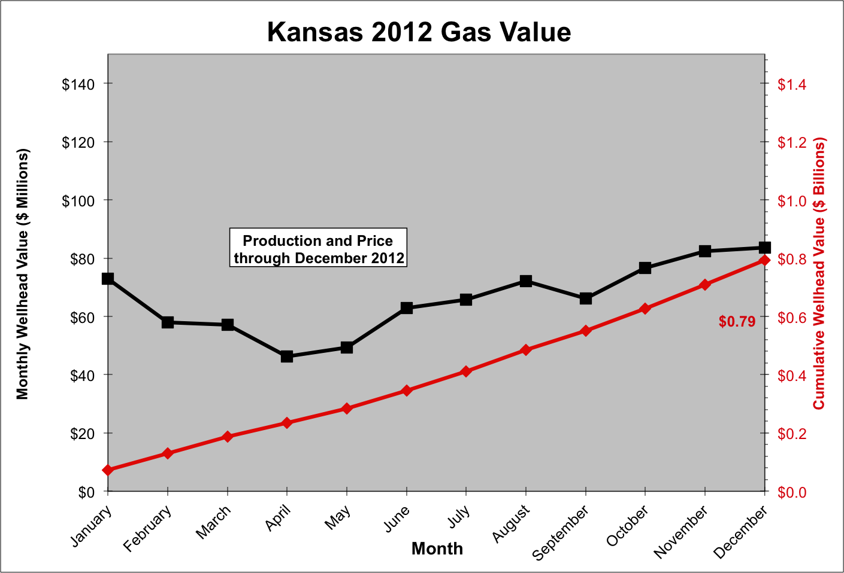
2012 Kansas Gas Value
Notes:
Wellhead Prices from EIA of the US DOE
http://www.eia.doe.gov/pub/oil_gas/natural_gas/data_publications/natural_gas_monthly/current/pdf/table_04.pdf

Slide 38
2013 Kansas Gas Value
Notes:
Wellhead Prices from EIA of the US DOE
http://www.eia.gov/naturalgas/monthly/
Used Natural Gas Spot Price on PDF.

Slide 39
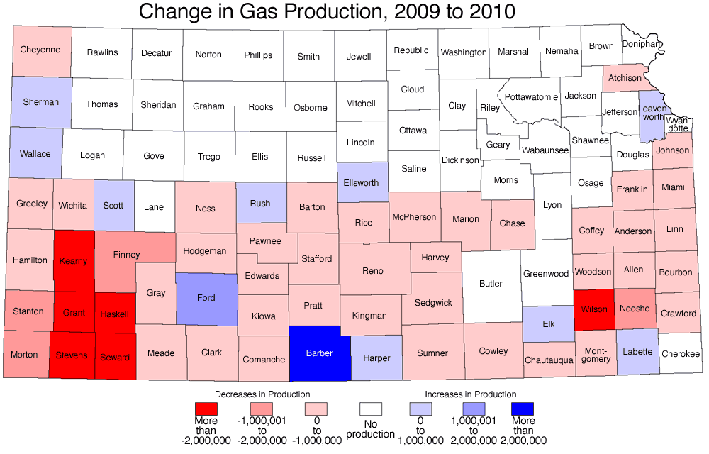
County Gas Production
Notes:
Created June 2008.

Slide 40
Eastern Kansas Gas Production
2007 Production through December
2007 Wellhead Price through December
Includes : Allen, Bourbon, Coffey,
Crawford, Labette, Miami, Montgomery,
Neosho, Wilson counties
Notes:
2004 Well Prices from EIA
Jan $5.53
Feb $5.15
Mar $4.97
Apr $5.20
May $5.63
Jun $5.85
Jul $5.60
Aug $5.36
Sep $4.86

Slide 41
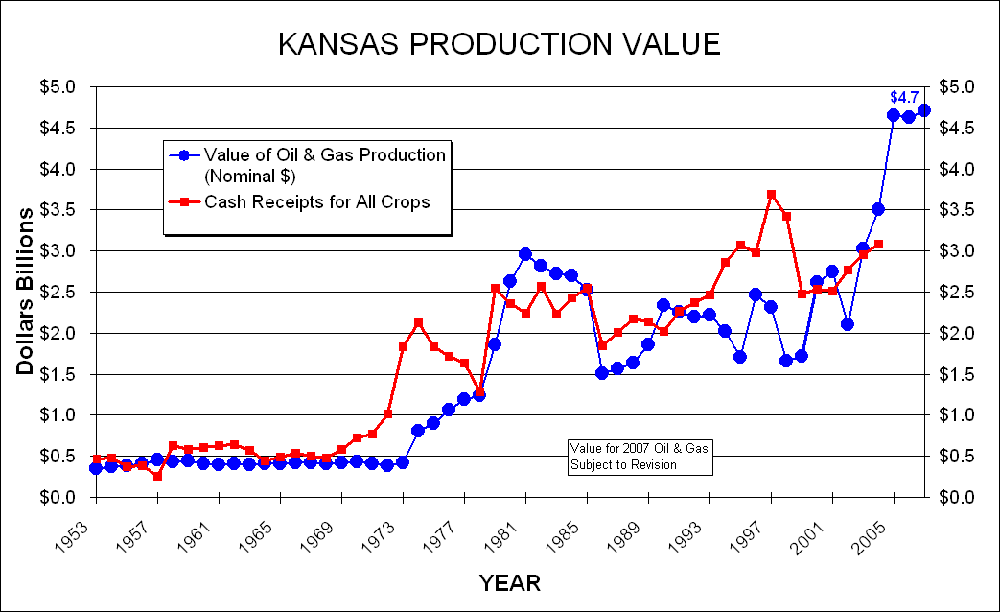
Value of Oil & Gas
Notes:
Total value of Kansas 2005 oil and gas production at the wellhead is estimated to be more than $4.7+ billion. This is up from an estimated $3.5 billion in 2004.
Cash Receipts for All Crops from 2004 Kansas Farm Facts (p 93)
http://www.nass.usda.gov/ks/ffacts/2005/pdf/economics.pdf

Slide 42
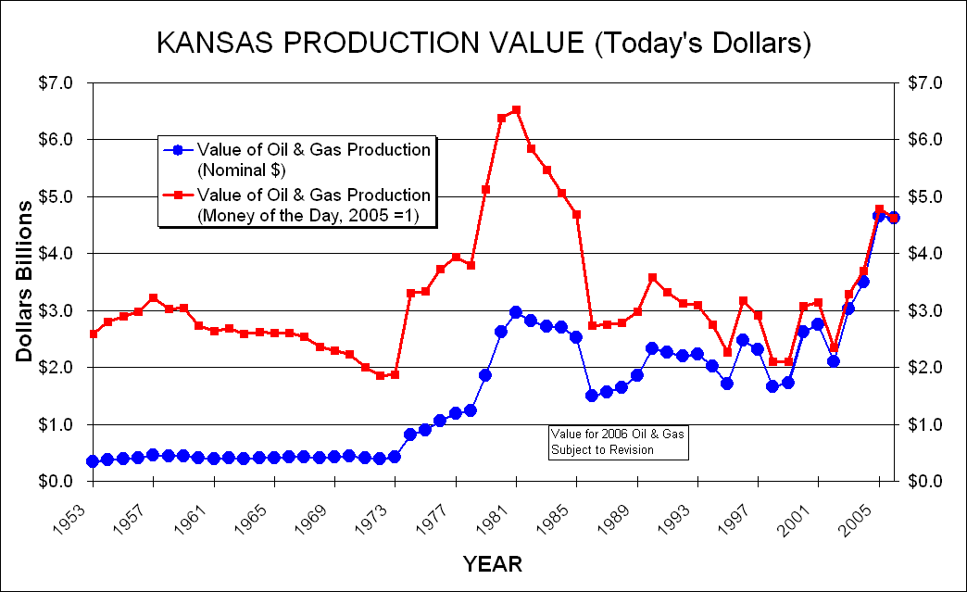
Value of Oil & Gas
Notes:
Total value of Kansas 2005 oil and gas production at the wellhead is estimated to be more than $4.7+ billion. This is up from an estimated $3.5 billion in 2004.
Cash Receipts for All Crops from 2004 Kansas Farm Facts (p 93)
http://www.nass.usda.gov/ks/ffacts/2005/pdf/economics.pdf

Slide 43
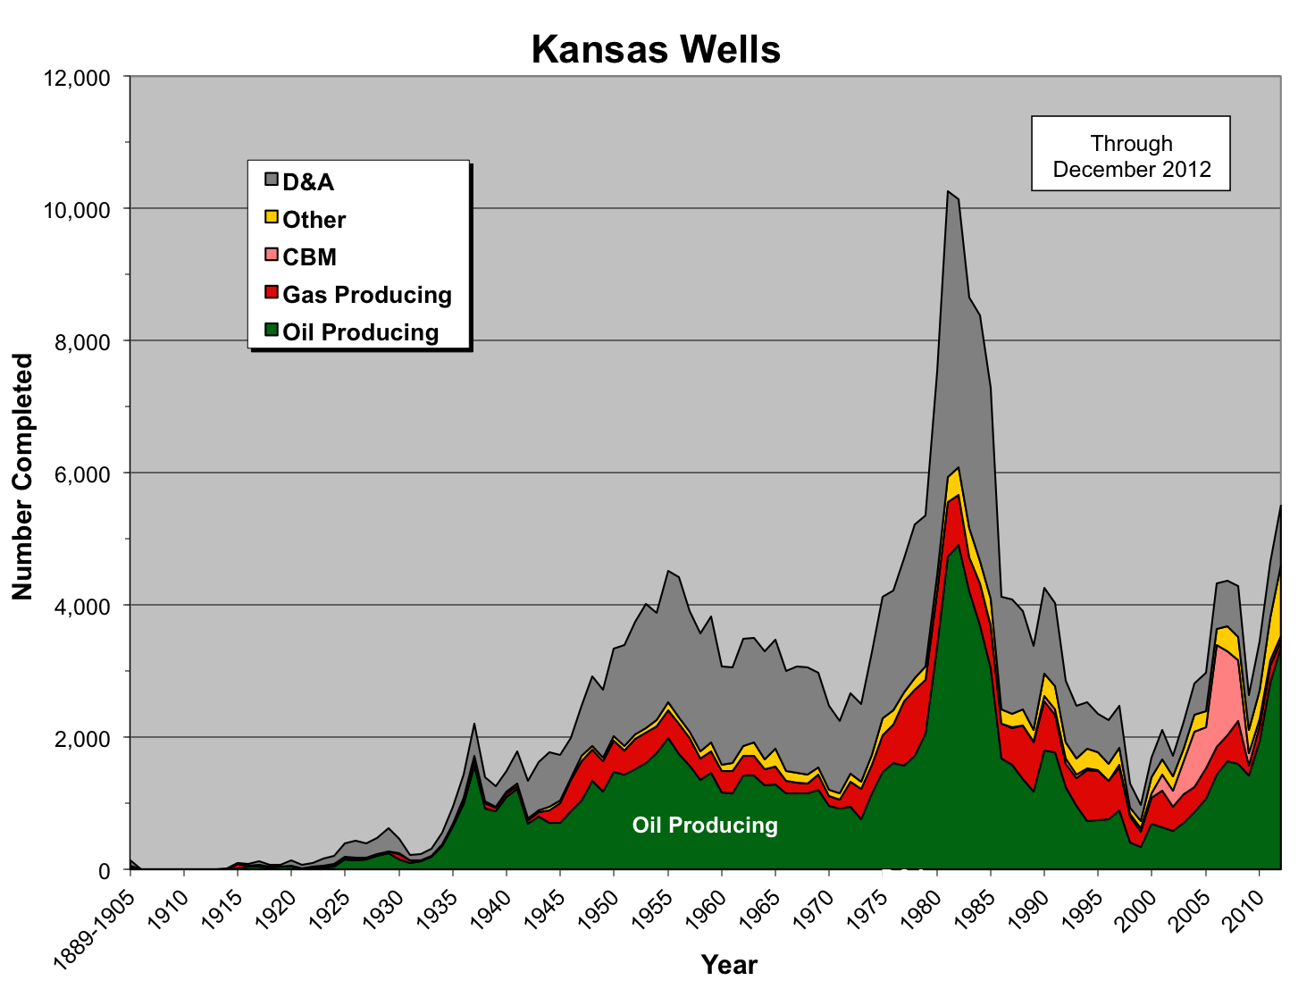
Kansas Well Activity

Slide 44
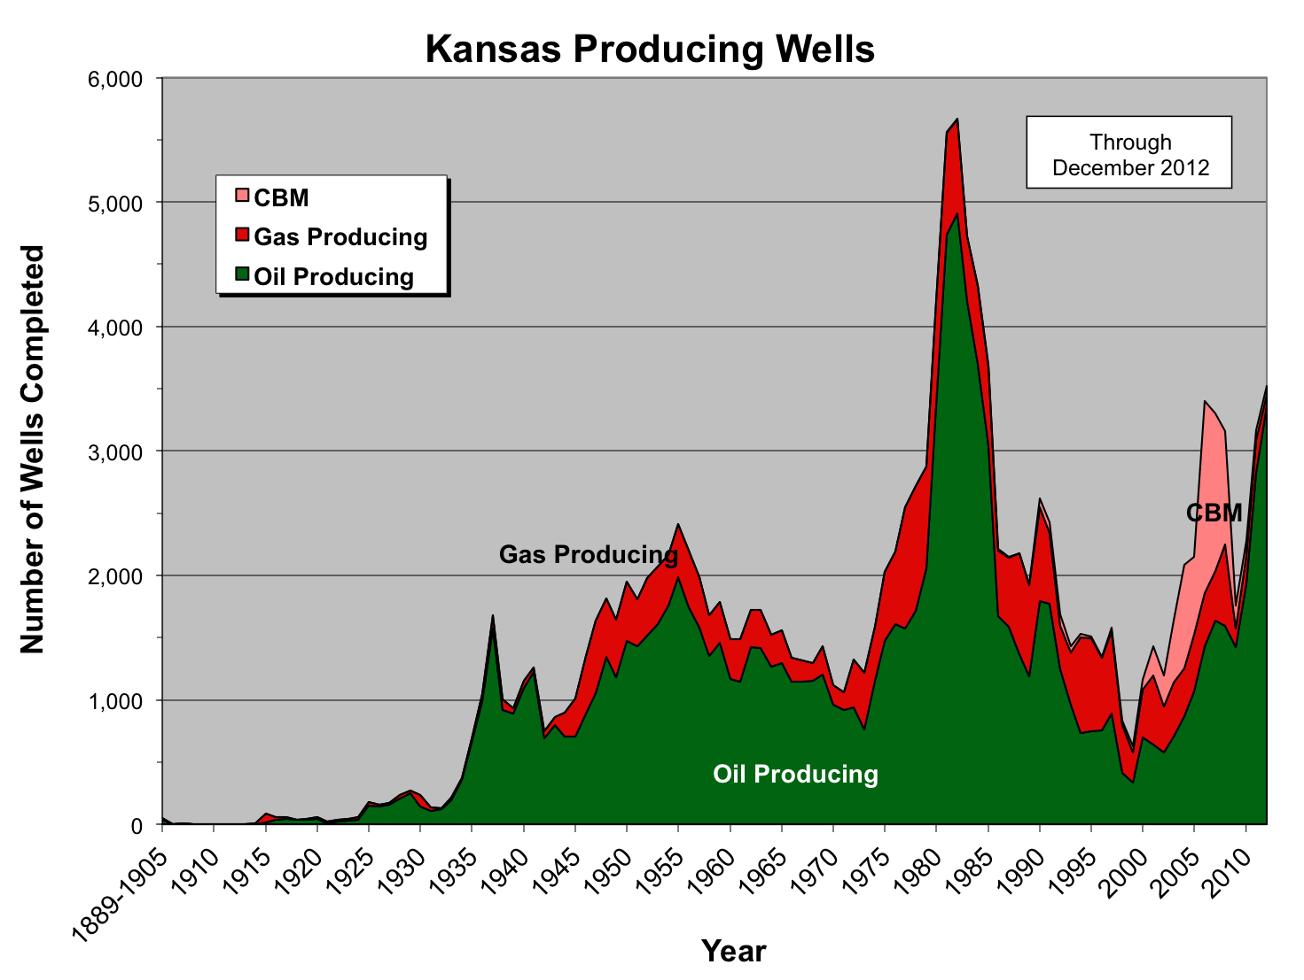
Kansas Well Activity

Slide 45
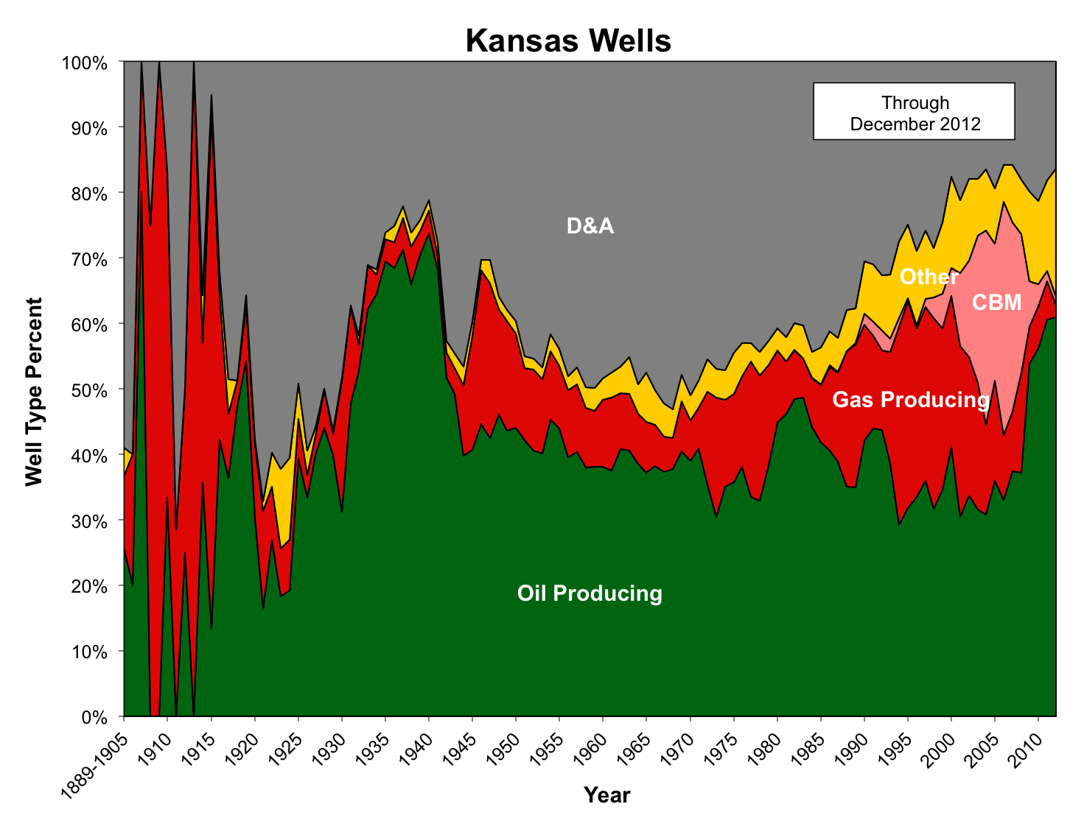
Kansas Well Activity

Slide 46
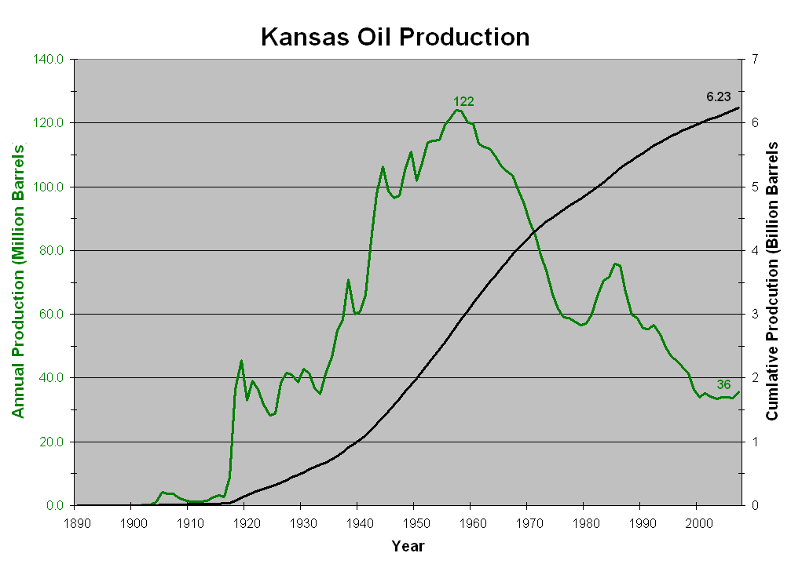
Kansas Historical Oil Production
Recession of 1958
Waterflooding
TX Railroad Commission Sets Proration @ 100% - 1971
Reflection Seismic
Rotary Drilling
Suez Crisis 1956
Saudis Increase Production
(2 to 5 mmbd) - 1986
Surface Anticlines
Yom Kippur War, Arab Oil Embargo - 1973
Oil Price Controls - 1973
Iran-Iraq War - 1980
OPEC Quota Increase - 1997
Notes:
1956 was the Peak Production at 124 Mi

Slide 47
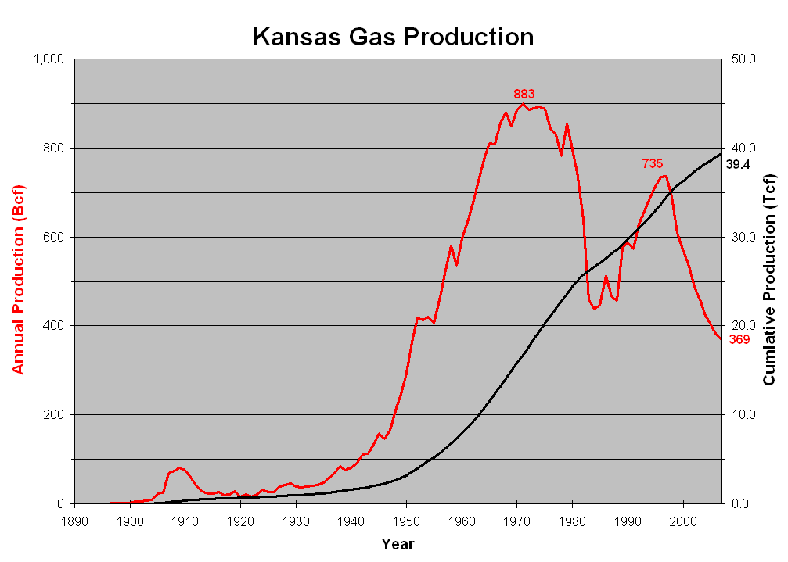
Kansas Historical Gas Production
Power Plant & Industrial Fuel Use Act - 1978
Energy Policy & Conservation Act - 1975
Fracture Treatment - 1950
Construction of Big Inch
& Little Inch
Price & Allocation Decontrol - 1981
KCC Infill Order - 1086

